Slide 1

Computer Vision Applications
By Quadeer Shaikh

Slide 2

About me
Work Experience
Risk Analyst
Morgan Stanley (Jan 2023 – Present)
Data Science Intern
AkzoNobel Coatings International B.V. Netherlands (Feb 2022 – Dec 2022)
Data Science Intern
EzeRx Health Tech Pvt. Ltd. (Jan 2022 – July 2022)
Associate Engineer
Tata Communications Ltd. (July 2019 – Aug 2020)
Network Automation and Analysis Engineer Intern
Cisco (June 2018 – July 2018)
Education
M.Tech – Artificial Intelligence
NMIMS (2021 - 2023, currently pursuing)
B.E. – Computer Engineering
Mumbai University (2015 - 2019)

Slide 3
Visual Embeddings and One Shot Learning

Slide 4

Visual Embeddings
What are image embeddings? An image embedding is a lower-dimensional representation of the image. In other words, it is a dense vector representation of the image which can be used for different computer vision tasks. E.g. Classification
Usually is the output of the layer before the final layer (last fully connected layer)
This way, comparisons between images can be performed by measuring their pairwise distances in this embedding space.

Slide 5
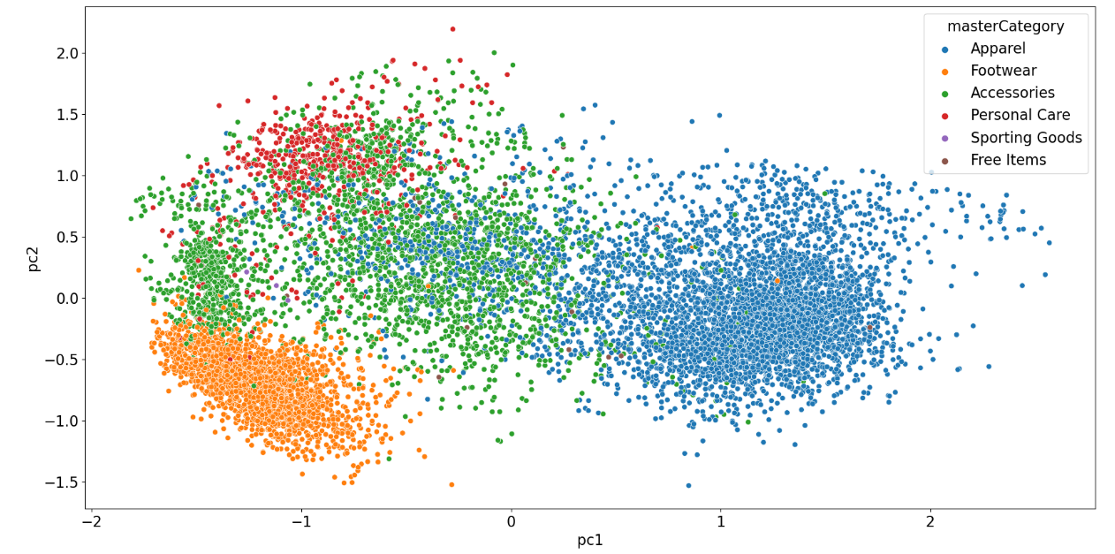
Visual Embeddings: Projected in 2D using Dimensionality Reduction

Slide 6
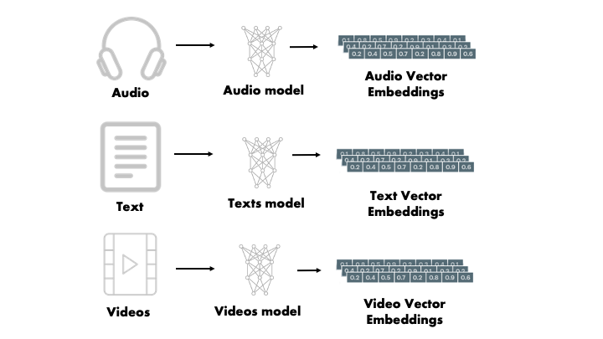
Embeddings: Formal Definition
An embedding is a vector space, typically of lower dimension than the input space, which preserves relative dissimilarity (in the input space). The terms vector space and embedding space are used interchangeably. Embeddings can be extracted for any kind of data form.

Slide 7
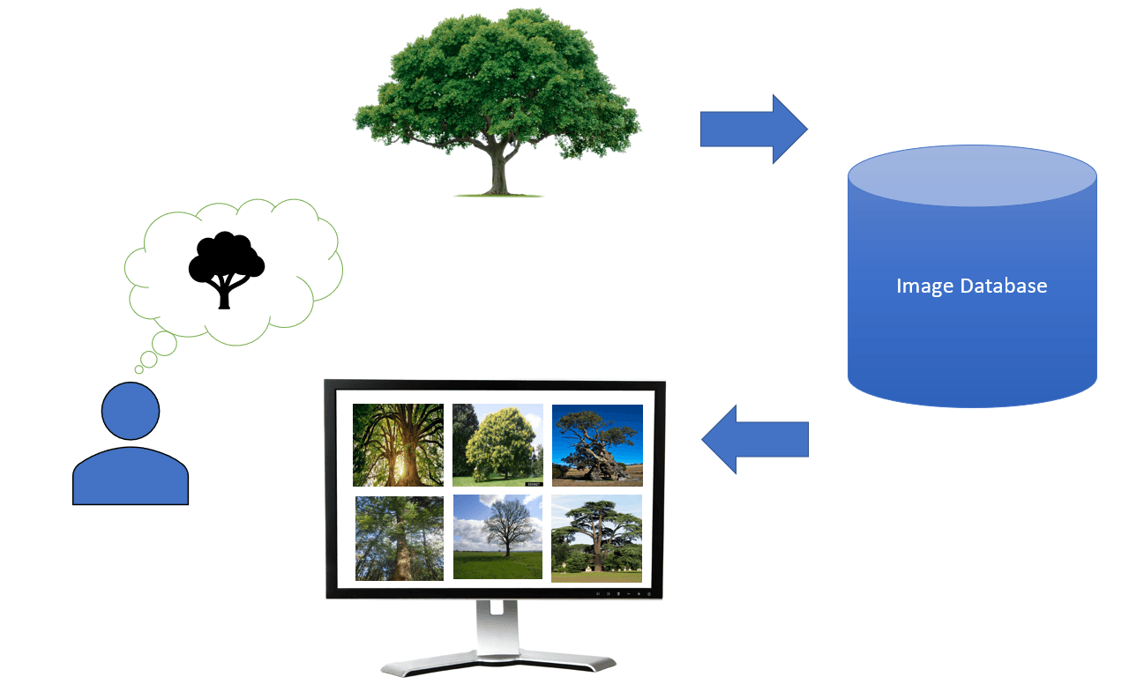
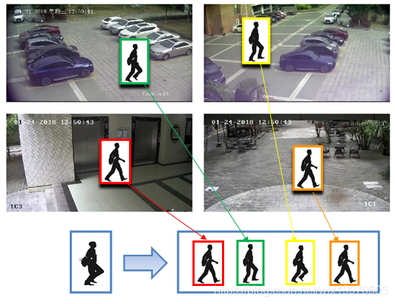
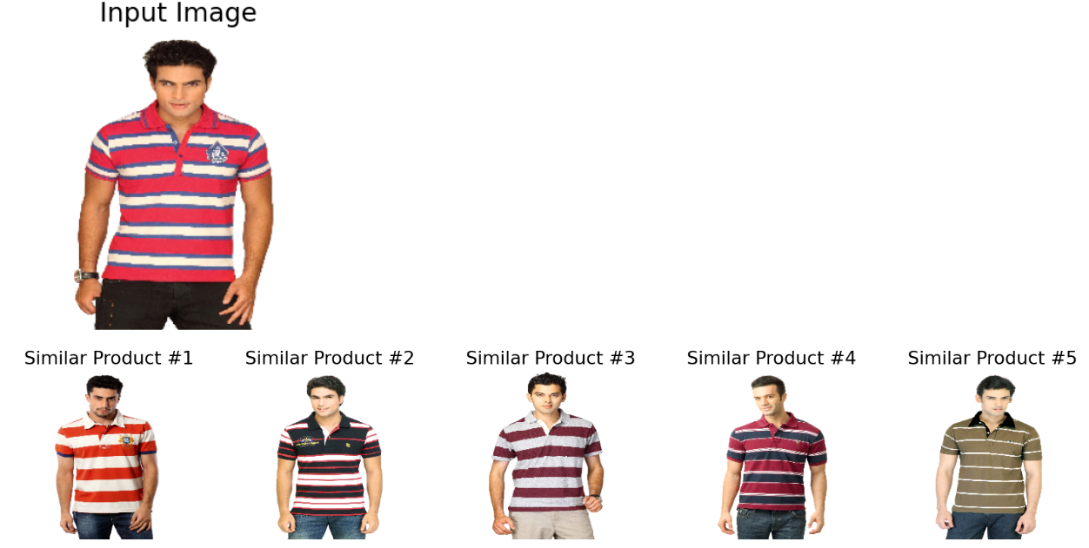
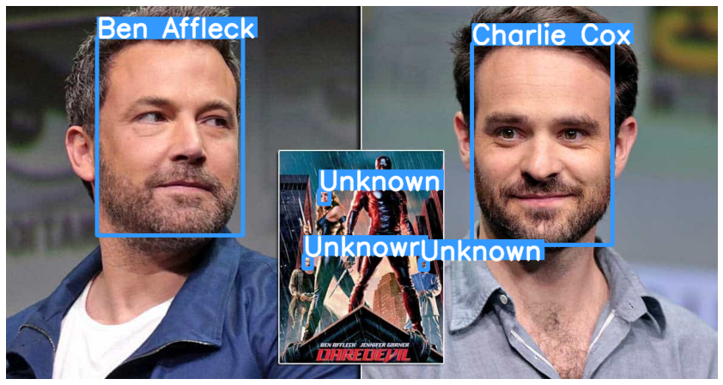
Applications of Visual Embeddings
Image Recommendation Systems
Reverse Image Search Engines
Face Recognition
Object Re-Identification

Slide 8
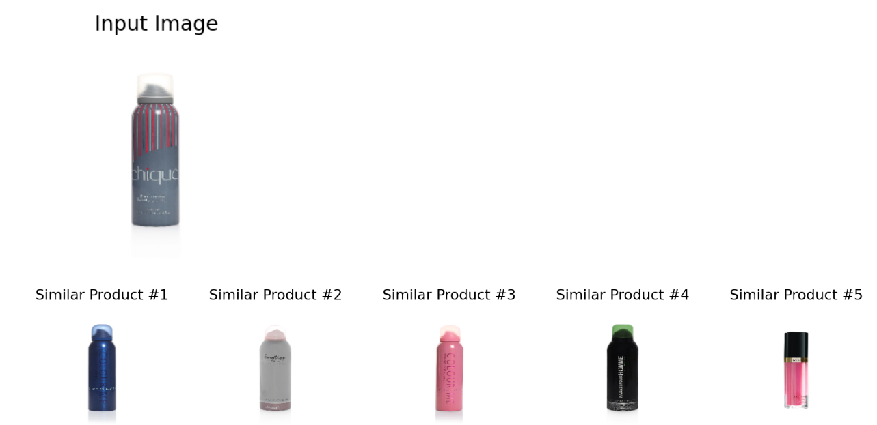
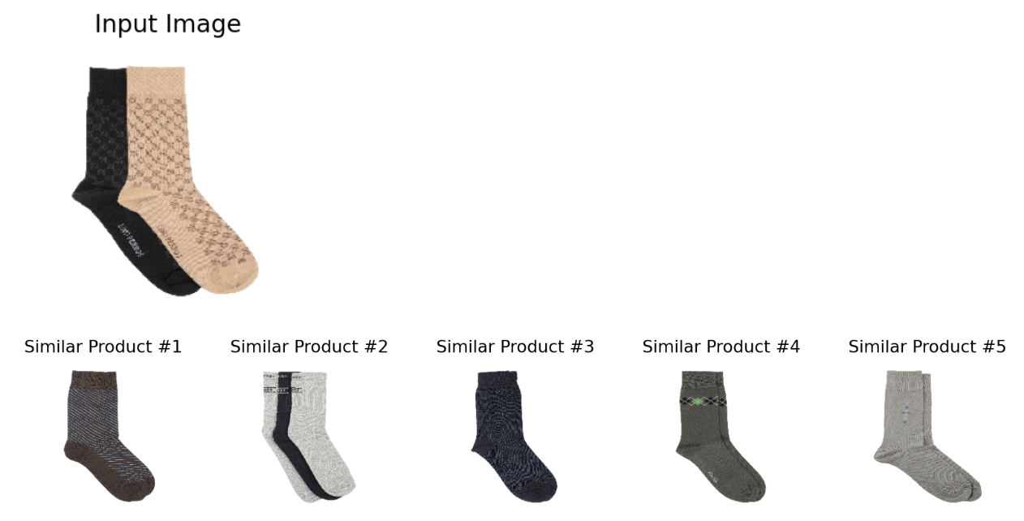
Reverse Image Search/Image Recommendation Approach
Extract visual embeddings using a pretrained network
Store the vector embeddings in a database
Provide input image -> calculate visual vector embedding
Calculate distance between input image embeddings and all the image embeddings in the database
Display the k-Nearest Neighbours based on the distance calculated
Note: In the examples shown, k = 5
Subjective metrics such as hit-rate and A/B tests are used to evaluate the success of these tasks

Slide 9

Face Recognition

Slide 10
One Shot Learning: Face Recognition
One-shot learning is an object categorization problem, found mostly in computer vision. Whereas most machine learning-based object categorization algorithms require training on hundreds or thousands of examples, one-shot learning aims to classify objects from one, or only a few, examples. The term few-shot learning is also used for these problems, especially when more than one example is needed.
Tasks like signature or face verification require the recognition of objects or faces. Deep learning algorithms typically require a lot of training data for these recognition based tasks. But, for a setup like face recognition we do not possess a large variety of photos for each person.

Slide 11
Face Recognition: Modes
Face Identification: One-to-many matches that compare a query face image against all the template images in the database to determine the identity of the query face
Person A’s image is compared with all the other people images present in the database
One to Many comparison
Face Verification: One-to-one match that compares a query face image against a template face image whose identity is being claimed.
Person A’s image is saved in the database, Person A’s new input image is compared with the existing image in the database
One to one comparison

Slide 12
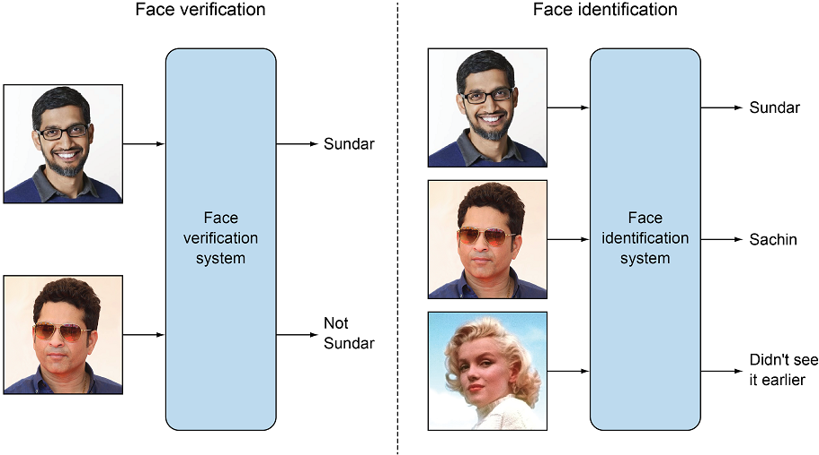
Face Verification
Face image embeddings of users stored in a database
User provides and input image, saying he is person A
Distance = L2(User’s face embeddings, Person A’s face embeddings)
If Distance < Distance threshold
The person is verified as person A
Else:
It is not person A

Slide 13
Face Identification
Face image embeddings of all users stored in a database
Person of interest identified
Person’s face embeddings calculated
Distance = L2(person’s face embeddings, face embeddings in DB)
Find the person id from the database with lowest distance
If distance < distance thresh
Person is person id with the lowest distance
Else
Person’s image is not present in the database

Slide 14
Face Recognition
Face Detection
Haar Cascades
Object Detection based models – MTCNN – Covered in Object Detection
Mediapipe – To be covered in next lecture
Face Alignment
Embedding Extraction
Face Identification/Verification

Slide 15


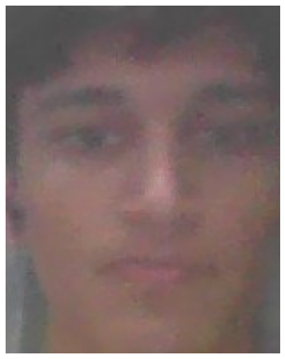


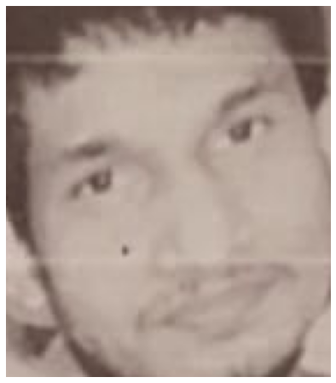
Face Detection: RoI

Slide 16
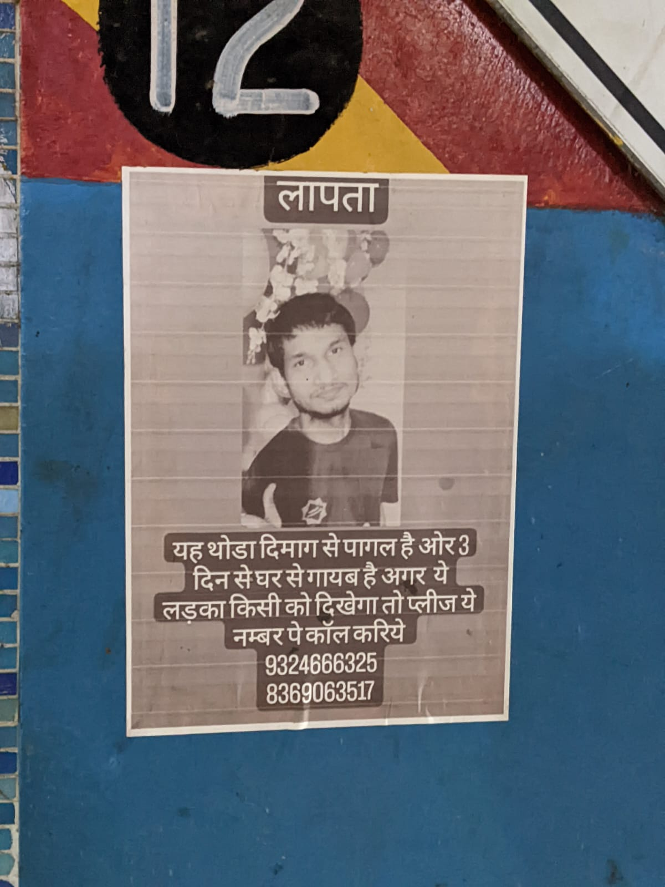





Face Detection: Full Images

Slide 17
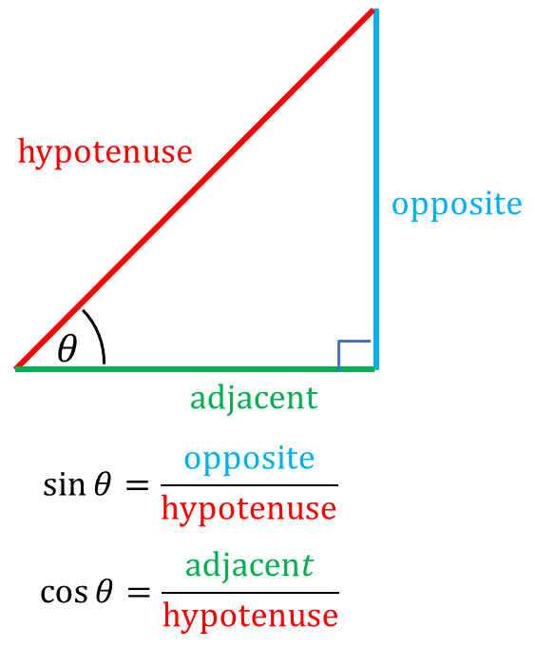
Face Alignment: 2D Alignment
Some math……..

Slide 18

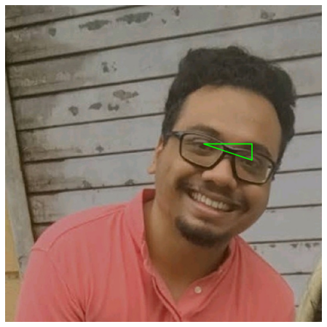
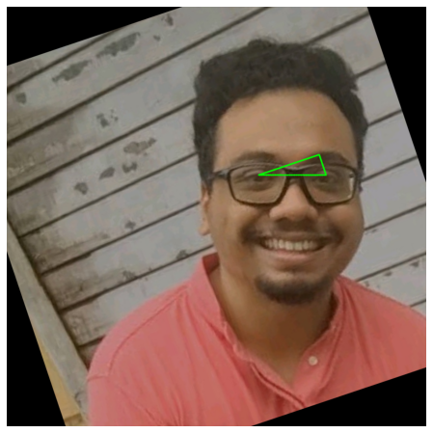
Face Alignment: 2D Alignment
Some math……..

Slide 19

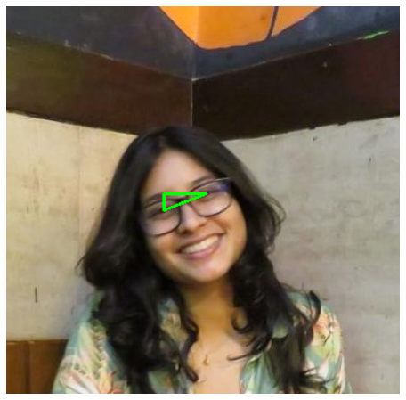

Face Alignment: 2D Alignment
Some math……..

Slide 20
Embedding Extraction and Face Recognition
What kind of network should we train for this one shot learning/few shot learning task ?
A model from scratch ?
A pretrained model ?

Slide 21
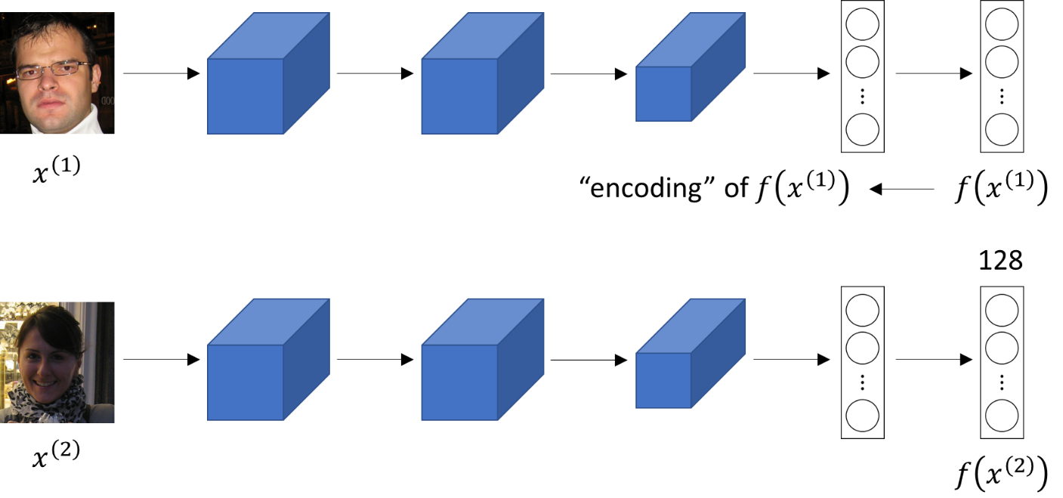
Siamese Network
A Siamese neural network (sometimes called a twin neural network) is an artificial neural network that uses the same weights while working in tandem on two different inputs to compute comparable output vectors.

Slide 22
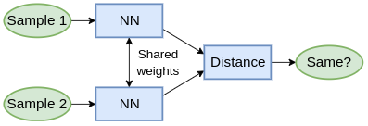
Siamese Network: L1/L2 Distance and Classification
Calculate the distance between the feature vectors
Pass this distance vector to the classification layer

Slide 23
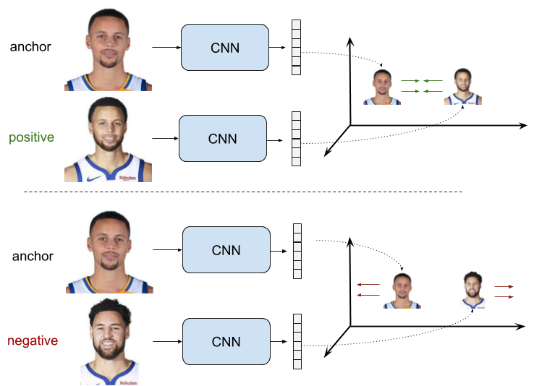
Siamese Network: Custom Loss
Contrastive Loss
Triplet Loss

Slide 24
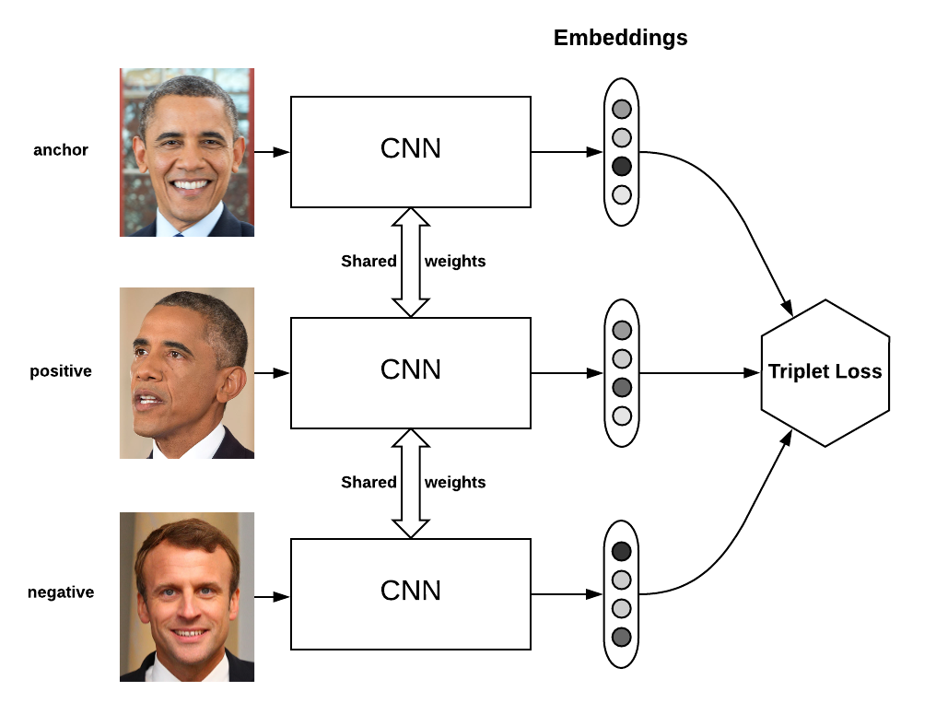
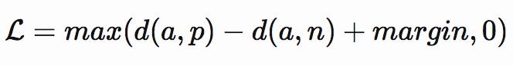
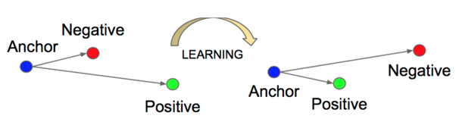
Siamese Network: Triplet Loss

Slide 25
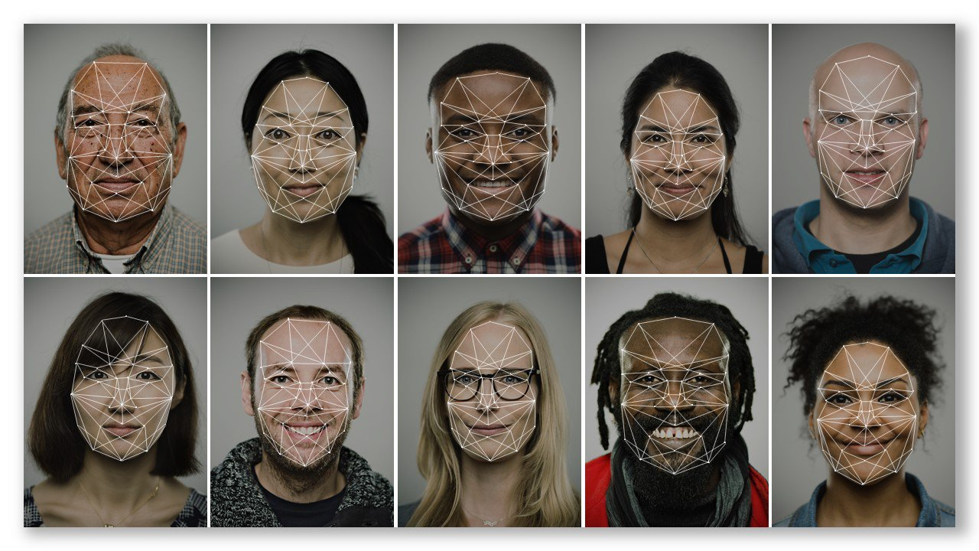
Important Aspects of Face Recognition Systems
Fairness
Transparency
Accountability
Non-discrimination
Notice and Consent
Lawful Surveillance

Slide 26
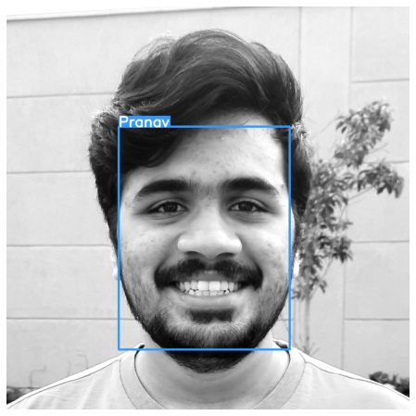
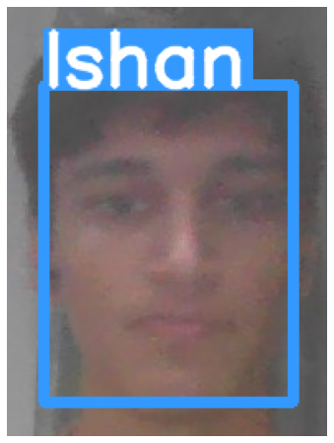
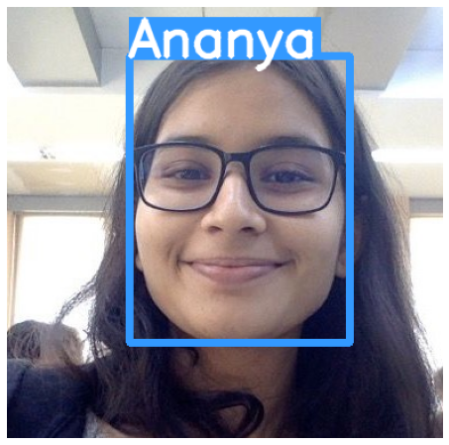
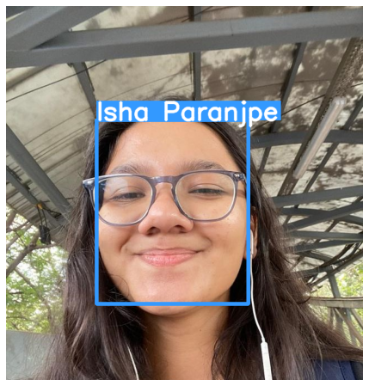
Applications of Face recognition
Auto Tagging on social media platforms
Authentication via Face Verification
Missing Person Identification

Slide 27
Thank you
For any queries drop an email at: quadeershaikh15.8@gmail.com

